Slide 1
WHERE DO WE GATHER APP
Capstone Project on IBM Data Science
by Leon Koltun 11-11-2019

Slide 2
Each year many Canadian companies conduct corporate meetups for their teams and stuff members for various purposes – celebrate a milestone, make an important announcement, discuss latest news, teambuilding activities, just afterwork/weekend fun etc.
It became a popular trend to get together outdoors, as it provides an opportunity for people to get out of their small cubicles and staffed offices, play sports and team games, refresh and stock up their energies in nature. And it suits corporate low-budget restrictions as well.

Slide 3
But here’s the question – which park to choose? More than that, most people like variety and exploring new places and so they prefer to meet in a new park every time. What comes with a new territory, however, is uncertainty, as organizers are not familiar with every outdoor place out there. More than that, different parks are good for some activities, and not a very good fit for other activities. For example, if a team votes for a marathon day upon their next gathering, the suitable place should be laced with long trails and have washrooms (and possibly showers). And in case of a barbeque event, there should be green lawns equipped with BBQ grills and permitted for fire. Swimming and fishing activities are perfect in waterfront areas. One of the determining factors for selecting a place - what’s around and how far is it? For instance, after a long day at the beaches, the team might want to have a lunch in the restaurant. The cuisine preference will be also decided by most votes.
There are times however, when event organizers will change course at the last moment and seek for some other option at the last resort. Such as in case of deteriorating weather conditions, when it becomes obvious it’s going to rain, but taking a ‘rain-check’ is not an option, as all plans were made in advance. In such a case the planners will have to quickly come up with an alternative solution, by throwing another vote among the team and then promptly explore various other venues, according to the decided criteria.

Slide 4
The app might be a nice assistant to Greater Toronto Area (GTA) corporations, that nourish a culture of team building and employee engagement.
The planning committee will collect the votes of all participating employees in terms of the area to explore, the type of activity and ‘afterparty lunch’. The preferences, receiving most votes, will be loaded into a function as input parameters, and the function will output a list of most suitable outdoor places (by default) to go, within a radius chosen. It will be sorted by distance range. Comments from users will render essential information in terms of general user experience and what can be done in that place. The assumption is that an advice from unknown user is trusted. In case of changing weather conditions, the function will be run again with a new set of input parameters. The output report will present the data in a table format and as a map with recommended places on it, for easier orientation. Each place will be associated with a particular group (cluster), that was classified by Machine Learning algorithm.

Slide 5
Data acquisition
Foursquare.com for geolocation data
Wikipedia – general stats of GTA
CSV file with GTA neighborhood coordinates

Slide 6

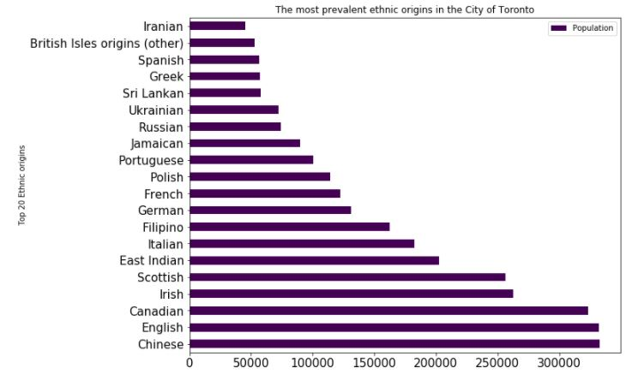
Toronto ethnic diversity

Slide 7
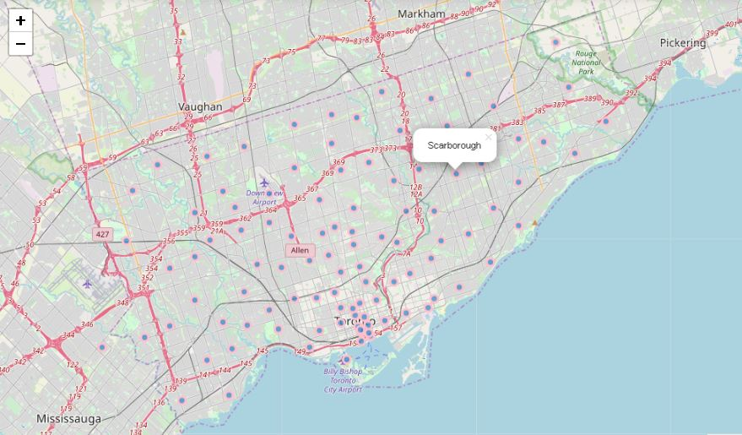
Map of greater Toronto area

Slide 8
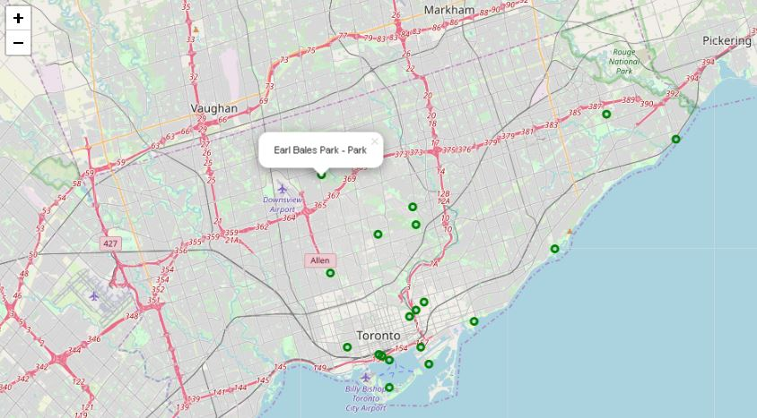
Selected park – earl bales on the map

Slide 9
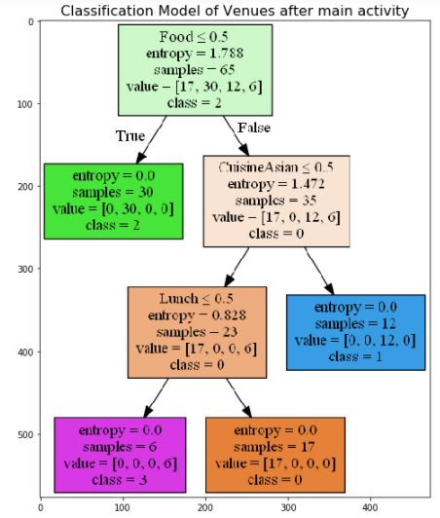
Decision Tree Classifier

Slide 10
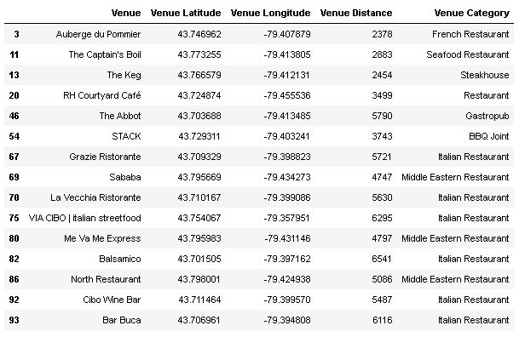
Dining places, found by the model in the park vicinity

Slide 11
Conclusion
The Decision Tree Classifier and K-Means Clustering Machine Learning algorithms have produced the same classification results.
The next Phase II of this project can be taking the distance ranges into account, providing 3 circles of accessibility to dining places with short, mid and long-range distances from the park. Also, the 'agreeCount' and 'disagreeCount' could be incorporated to weight Tips from other visitors. This feature, however, will make sense to add on commercial application only, as it will necessitate at least the "Start Up Tier" with Foursquare, in order to bypass the 1-tip-per-venue limit. Next Phases of the project can extend on other territories, provinces and countries, as Foursquare provides worldwide geolocation data. The Park - Restaurant scenario can change into something else, as there's no limitation of Categories within the Application

